Slide 1
CANNY ALGORITHM
EDGE DETECTION
WITH CUDA
FATIMA QARNI

Slide 2
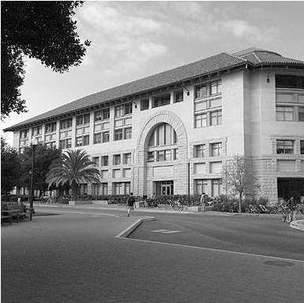
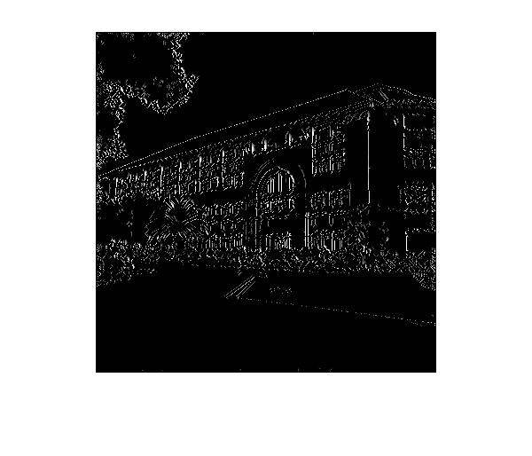
Output of Edge Detector
BEFORE
AFTER

Slide 3
Computationally
Intensive?
Need to do calculations on each pixel in the image for each step
Could be millions of calculations depending on number of pixels

Slide 4
Canny Algorithm Steps
Each step builds on the previous one
But each step can be parallelized – individual pixel calculations are independent
GAUSSIAN BLUR
FIND GRADIENTS
NON-MAXIMUM
SUPRESSION
DOUBLE
THRESHOLDING
HYSTERESIS:
EDGE TRACKING
Remove background noise
Detect edge intensity and direction
Thin out the thick edges
Identify strong, weak, and irrelevant pixels
Choose relevant pixels

Slide 5

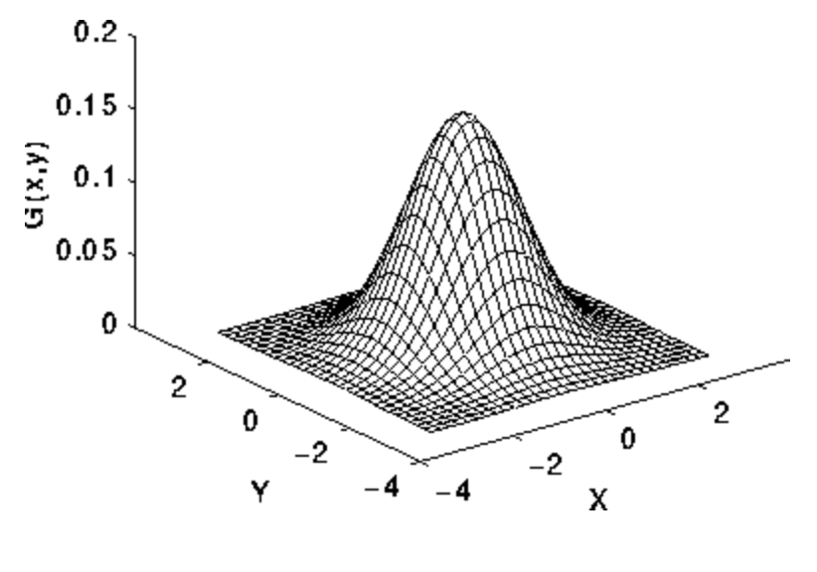
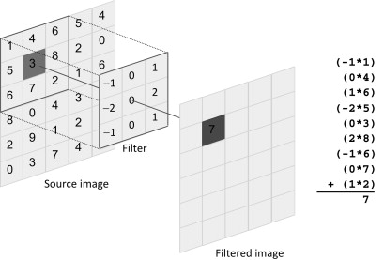
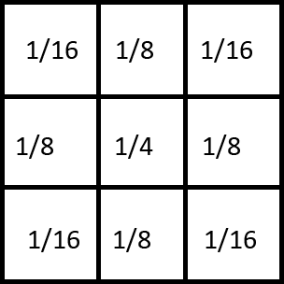
Gaussian Blur
HOW IT WORKS
Noise: random variation of brightness/intensity
Edge detection can be effected by noise
Removes noise by blurring image
Gaussian distribution: puts more weight at the center and less around the edges
Can choose kernel (filter) size
Larger kernel: blurrier output
Convolution:
Gaussian Distribution
KERNEL SIZE: 10x10

Slide 6
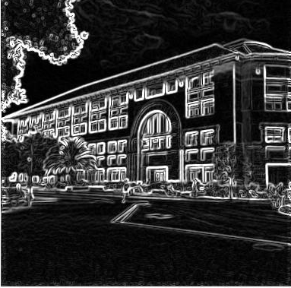
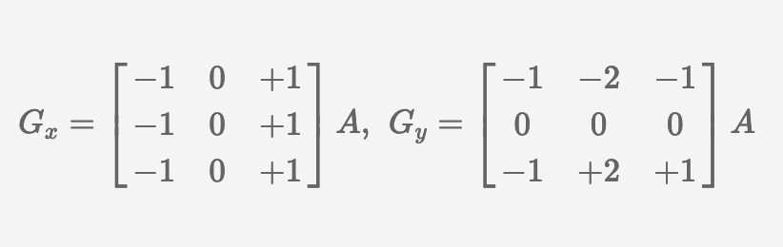
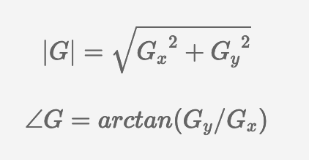
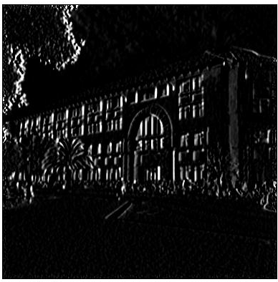
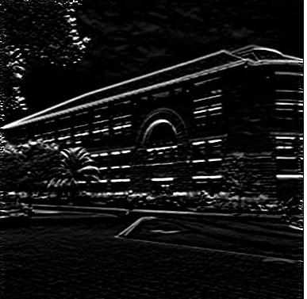
Find Gradients
HOW IT WORKS
Edges: where the image color changes
Sobel filters: highlight intensity change in x and y directions
Apply with convolution
Then combine to find magnitude and direction of each pixel
Sobel Filters:
X AXIS FILTER
Y AXIS FILTER

Slide 7

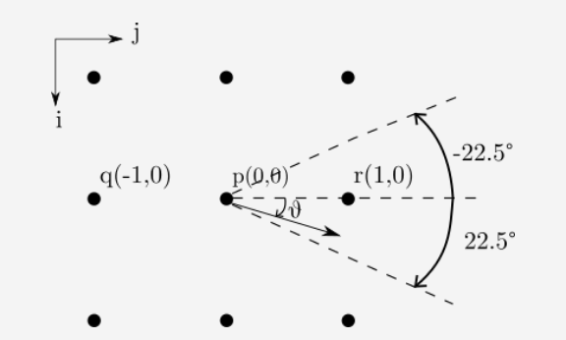
Non-Maximum
Suppression
HOW IT WORKS
Previous result gave us thick and thin edges – we only want thin
Thicker edges are blurry
Using gradient direction for each pixel:
Compare adjacent pixels in gradient direction
If intensity is greater than both pixels, then keep this pixel, else make black

Slide 8

Double Thresholding
HOW IT WORKS
Previous output gave us pixels of varying intensities
Identifies types of pixels: Strong, Weak, and Irrelevant, based on two threshold values
Above upper threshold: Strong pixel
Below upper threshold & above lower threshold: Weak pixel
Below lower threshold: Irrelevant pixel
STRONG PIXELS

Slide 9
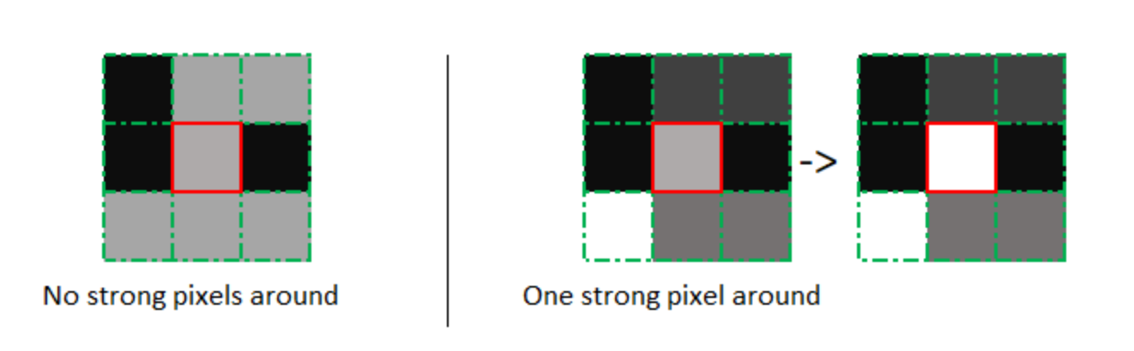
Edge Tracking with
Hysteresis
HOW IT WORKS
Select which of the pixels to use based on the classification from Double Thresholding
Strong: keep pixel
Irrelevant: don’t keep pixel (turn black)
Weak pixel: keep only if any of its adjacent pixels are strong

Slide 10
Unoptimized
Performance
AVERAGE IMAGE TIMING / IMAGE:
90000 PIXELS: 48 MS
147456 PIXELS: 72 MS
2250000 PIXELS: 496 MS
5760000 PIXELS: 188 MS
23040000 PIXELS: 698 MS
1 BLOCK / PIXEL
1 THREAD / BLOCK

Slide 11
Optimization 1:
Threads/Block
BEST AVERAGE TIMING / IMAGE:
90000 PIXELS: 40 MS (ORIG: 48 MS)
147456 PIXELS: 40 MS (ORIG: 72 MS)
2250000 PIXELS: 114 MS (ORIG: 496 MS)
5760000 PIXELS: 152 MS (ORIG: 188 MS)
23040000 PIXELS: 462 MS (ORIG: 698 MS)

Slide 12
Opt 2: Shared Memory for Gaussian Blur
Loads the most data from input global memory matrix
Write all block pixel data to shared memory
Each thread loads current position’s pixel into shared memory
Pixels on border of block: load edges
Current Pixel
Current Pixel
Notes:
Download more minimal templates here: https://crmrkt.com/GK9Dwa

Slide 13
Optimization 2:
Shared Memory
BEST AVERAGE TIMING / IMAGE:
90000 PIXELS: 36.25 MS (PREV: 40 MS)
147456 PIXELS: 37.5 MS (PREV: 40 MS)
2250000 PIXELS: 148 MS (PREV: 114 MS)
5760000 PIXELS: 135 MS (PREV: 152 MS)
23040000 PIXELS: 463 MS (PREV: 462 MS)

Slide 14
Optimization 3:
Padding (WIP)
More padding: half of kernel size on each side
Less padding: 1 extra space at end of array

Slide 15
MATLAB & Python?
RESULTS:
Python: much slower
MATLAB faster up to a point
On average, CUDA is faster
Linear (Python)

Slide 16
Questions?
Notes:
Download more minimal templates here: https://crmrkt.com/GK9Dwa

